Slide 1
AI, Machine Learning & Deep Learning

Slide 2
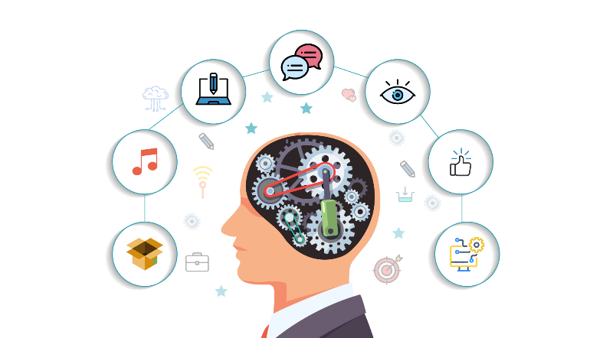
Artificial intelligences
Artificial intelligence is a machine that mimics a "cognitive" function of human mind

Slide 3
Let’s Talk About How Artificial Intelligence Came Into Existence
The term “Artificial Intelligence” was actually coined way back in 1956 by John McCarthy, a professor at Dartmouth.
For years, it was thought that computers would never match the power of the human brain, but this has proven to not be the case.
That time we did not have enough data and computation power, but now with Big Data coming into existence and with the advent of GPUs, Artificial Intelligence is possible.
90% of the world’s data has been generated in the past two years alone?
Artificial Intelligence being a little less artificial and a lot more intelligent
50% chance that Artificial Intelligence would be developed between 2040 and 2050,
rising to 90% by 2075.

Slide 4
Use Case
Artificial Intelligence In Sports – A Computer System That Defeats A World Champion – Deep Blue
Deep Blue won its first game against a world champion on 10 February 1996, when it defeated Garry Kasparov in game one of a six-game match.
However, Deep Blue was then heavily upgraded and played Kasparov again in May 1997.
Deep Blue became the first computer system to defeat a reigning world champion in a match under standard chess tournament time controls.
Wildlife Poaching Prevention
For Smart Agriculture
In Healthcare – Better Surgeries And Prosthetics
Tracking Wildlife Populations
Rescue Missions

Slide 5
Why “Learn”?
Machine learning is programming computers to optimize a performance criterion using example data or past experience.
There is no need to “learn” to calculate payroll
Learning is used when:
Human expertise does not exist (navigating on Mars),
Humans are unable to explain their expertise (speech recognition)
Solution changes in time (routing on a computer network)
Solution needs to be adapted to particular cases (user biometrics)

Slide 6
What We Talk About When We Talk About“Learning”
Learning general models from a data of particular examples
Data is cheap and abundant (data warehouses, data marts); knowledge is expensive and scarce.
Example in retail: Customer transactions to consumer behavior:
People who bought “Da Vinci Code” also bought “The Five People You Meet in Heaven” (www.amazon.com)
Build a model that is a good and useful approximation to the data.

Slide 7
What is Machine Learning?
Machine Learning
Study of algorithms that
improve their performance
at some task
with experience
Optimize a performance criterion using example data or past experience.
Role of Statistics: Inference from a sample
Role of Computer science: Efficient algorithms to
Solve the optimization problem
Representing and evaluating the model for inference

Slide 8
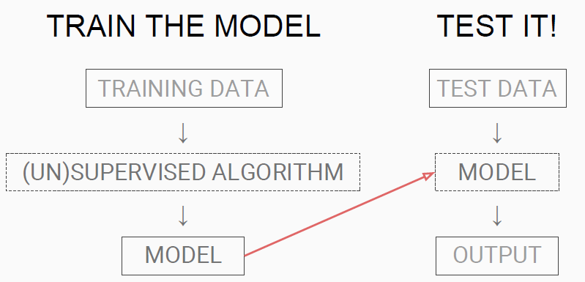
Overview

Slide 9
Growth of Machine Learning
Machine learning is preferred approach to
Speech recognition, Natural language processing
Computer vision
Medical outcomes analysis
Robot control
Computational biology
This trend is accelerating
Improved machine learning algorithms
Improved data capture, networking, faster computers
Software too complex to write by hand
New sensors / IO devices
Demand for self-customization to user, environment
It turns out to be difficult to extract knowledge from human experts→failure of expert systems in the 1980’s.

Slide 10
Type of Learning
Supervised Learning
Classification
Regression/Prediction
Unsupervised Learning
Reinforcement Learning

Slide 11
Drawbacks of the Machine Learning
Traditional ML algorithms are not useful while working with high dimensional data, that is where we have a large number of inputs and outputs. For example, in case of handwriting recognition we have large amount of input where we will have different type of inputs associated with different type of handwriting.
Second major challenge is to tell the computer what are the features it should look for that will play an important role in predicting the outcome as well as to achieve better accuracy while doing so. This very process is referred as feature extraction.

Slide 12
Neural network
Artificial neural networks are a computational model based on simple neural units

Slide 13
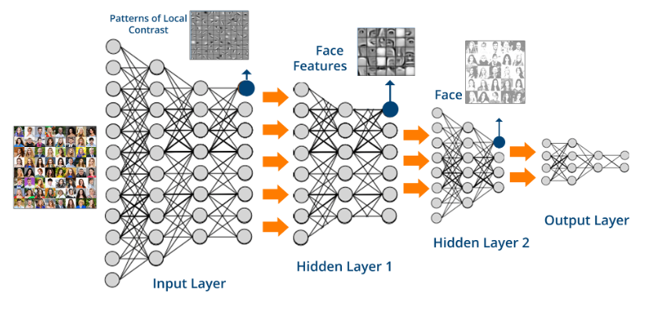
Deep Learning
Deep Learning is a subfield of machine learning concerned with algorithms inspired by the structure and function of the brain called artificial neural networks.

Slide 14
